Slide 1
Uncertainty-aware Attention and Interpretation Methods
Heo, Jay, et al. "Uncertainty-aware attention for reliable interpretation and prediction." Advances in Neural Information Processing Systems. 2018.
Patro, Badri N., et al. "U-cam: Visual explanation using uncertainty based class activation maps." Proceedings of the IEEE International Conference on Computer Vision. 2019.
魏煜华 2020.10.16

Slide 2
Uncertainty-Aware Attention for Reliable Interpretation and Prediction
Heo, Jay, et al. "Uncertainty-aware attention for reliable interpretation and prediction." Advances in Neural Information Processing Systems. 2018.
Code: https://www.catalyzex.com/redirect?url=https://github.com/jayheo/UA

Slide 3
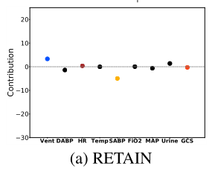
Introduction
Attention mechanism is effective in both focusing the deep learning models on relevant features and interpreting them.
Although interpretable, attention is still sometimes not reliable.
A reliable model
Can prevent itself from making critical mistakes.
Knows its own limitations.
Existing attention model can not handle this issue as they do not have any notion of predcitive uncertainty

Slide 4
Introduction
Uncertainty-aware attention model
Model the attention weights as Gaussian distribution with input dependent noise.
This input-adaptive noise can model heteroscedastic uncertainty
Confident → attentions with small variance
Not confident → noisy attentions with large variance

Slide 5
Approach

Slide 6
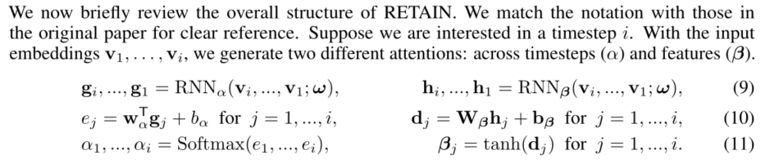
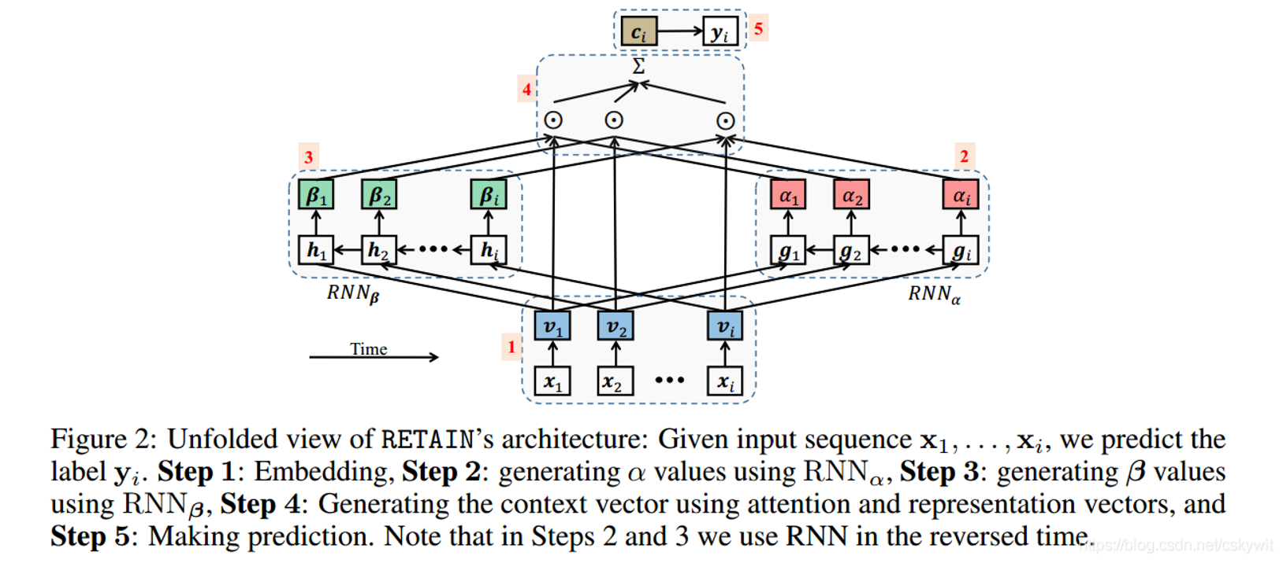
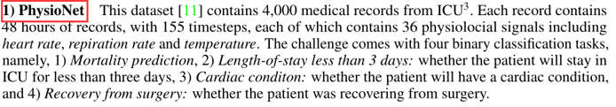
Application to RNNs for Prediction on Time-Series Data
RETAIN model
Step1: 使用线性embedding
Step2：产生visit-level attention。其中输入RNN中的数据采用时间逆序输入。Step3: 产生variable-level attention，其中输入RNN中的数据采用时间逆序输入。
Step4: 根据以上两步生成的attention weight，生成context vector。Ci表示病人第i次visit。
Step5: 根据Context Vector生成预测结果。

Slide 7
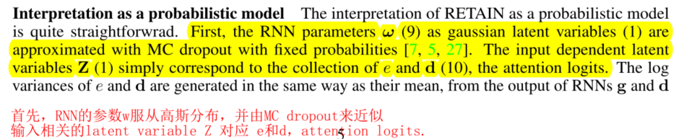
Application to RNNs for Prediction on Time-Series Data
Interpretation as a probabilistic model

Slide 8
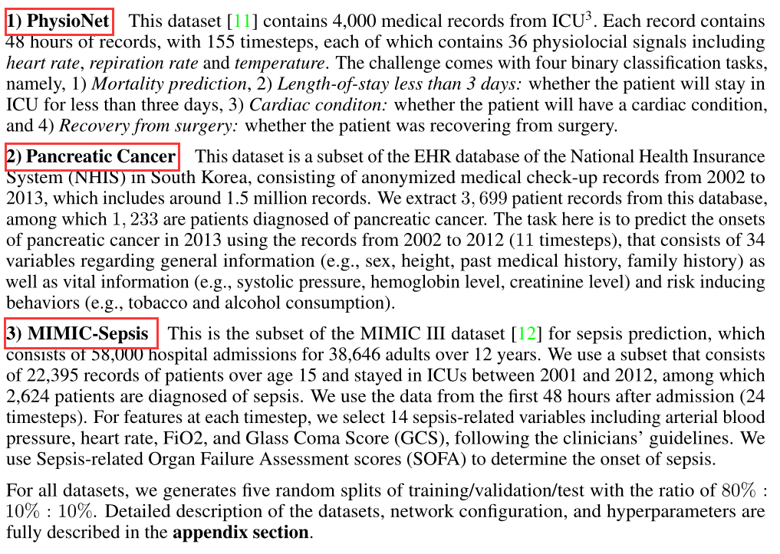
Experiments
Tasks and Datasets

Slide 9
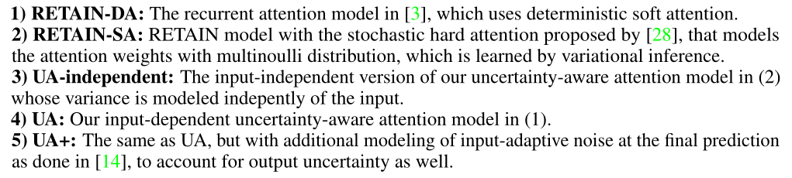
Experiments
Baselines

Slide 10
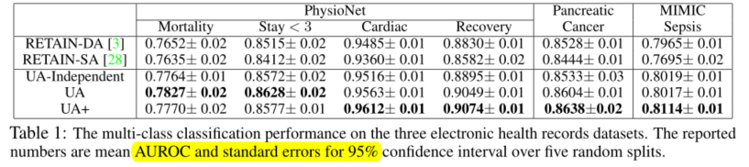
Experiments
Binary classification performance
We observe that UA variants significantly outperforms both RETAIN variants with either deterministic or stochastic attention mechanisms on all datasets
Note that RETAIN-SA, that generates attention from Bernoulli distribution, performs the worst. This may be because the model is primarily concerned with whether to attend or not to each feature, which makes sense when most features are irrelevant, such as with machine translation, but not in the case of clinical prediction where most of the variables are important. (注意，RETAIN-SA效果最差。这可能是因为模型主要关注是否关注每个特征，这在大多数特征无关的情况下是有意义的，比如机器翻译，但在临床预测的情况下不是这样，因为大多数变量是重要的)
UA-independent performs significantly worse than UA or UA+, which demonstrates the importance of input-dependent modeling of the variance. Additional modeling of output uncertainty with UA+ yields performance gain in most cases. (UA-independent的表现明显低于UA或UA+，这说明了input-dependent modeling of the variance 的重要性。在大多数情况下，UA与UA+产生性能增益)

Slide 11
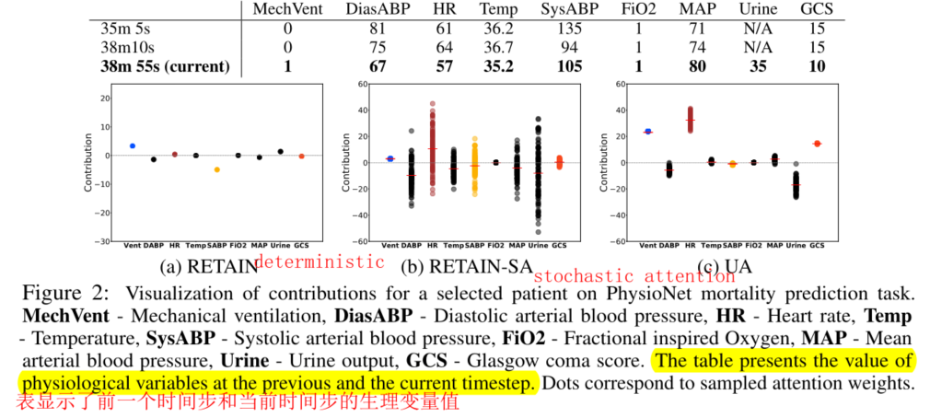
Experiments
Interpretability and accuracy of generated attentions
Analyze the contribution of each feature in PhysioNet mortality task for a patient at the timestep with the highest attention α, with the help of a physician.
1. 理论上来说，相对于baseline，UA能够提供更加精确得interpretation
2. current 和 previous tmesteps之间的差异是显著的： 体温、舒张动脉血压和心率都下降了，GCS(一种衡量意识的指标)也从15降到了10, 患者的MechVent和GCS评分降低，都是评估患者病情的重要标志
3. Heart rate is out of normal range (60-90), which is problematic but is not definitive, and thus UA attended to it with high variance. RETAIN-SA results in overly incorrect and noisy attention except for FiO2 that did not change its value. (心率超出正常范围(60-90)，这是有问题的，但不确定，因此UA attended to it with high variance。RETAIN-SA导致overly incorrect and noisy attention，除了FiO2没有改变其值)
4. The previous example shows another advantage of our model: it provides a richer interpretations of why the model has made such predictions, compared to ones provided by deterministic or stochastic model without input-dependent modeling of uncertainty. (前面的例子展示了我们模型的另一个优点:与不依赖于输入的不确定性模型的确定性或随机模型提供的预测相比，它更丰富地解释了为什么该模型做出了这样的预测，可以更好地解释模型)
Notes:
理论上来说，相对于baseline，UA能够提供更加精确得interpretation
The difference between the current and the previous tmesteps is significant - the patient is applied mechanical ventilation; the body temperature, diastolic arterial blood pressure, and heart rate dropped, and GCS, which is a measure of consciousness, dropped from 15 to 10. The fact that the patient is applied mechanical ventilation, and that the GCS score is lowered, are both very important markers for assessing patient’s condition. (current 和 previous tmesteps之间的差异是显著的; 体温、舒张动脉血压和心率都下降了，GCS(一种衡量意识的指标)也从15降到了10, 患者应用机械通气和GCS评分降低，都是评估患者病情的重要标志)
Our model correctly attends to those two variables, with very low uncertainty. SysABP and DiasABP are variables that has cyclic change in value, and are all within normal range; however RETAIN-DA attended to these variables, perhaps due to having a deterministic model which led it to overfit. (我们的模型正确地考虑了这两个变量，具有非常低的不确定性。SysABP和DiasABP是值循环变化的变量，都在正常范围内; 然而，RETAIN-DA关注这些变量，可能是由于具有确定性模型，导致其过度拟合)
Heart rate is out of normal range (60-90), which is problematic but is not definitive, and thus UA attended to it with high variance. RETAIN-SA results in overly incorrect and noisy attention except for FiO2 that did not change its value. (心率超出正常范围(60-90)，这是有问题的，但不确定，因此UA attended to it with high variance。RETAIN-SA导致overly incorrect and noisy attention，除了FiO2没有改变其值)
The previous example shows another advantage of our model: it provides a richer interpretations of why the model has made such predictions, compared to ones provided by deterministic or stochastic model without input-dependent modeling of uncertainty. (前面的例子展示了我们模型的另一个优点:与不依赖于输入的不确定性模型的确定性或随机模型提供的预测相比，它更丰富地解释了为什么该模型做出了这样的预测，可以更好地解释模型)

Slide 12
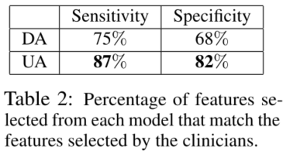
Experiments
Interpretability and accuracy of generated attentions
Further compared UA against RETAIN-DA for accuracy of the attentions, using variables selected meaningful by the clinicians as ground truth labels.(用临床医生选择的有意义的变量作为指导,进一步比较两种方法得到的attention的accuracy)
UA generates accurate interpretations that better comply with clinicians's

Slide 13
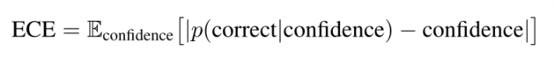
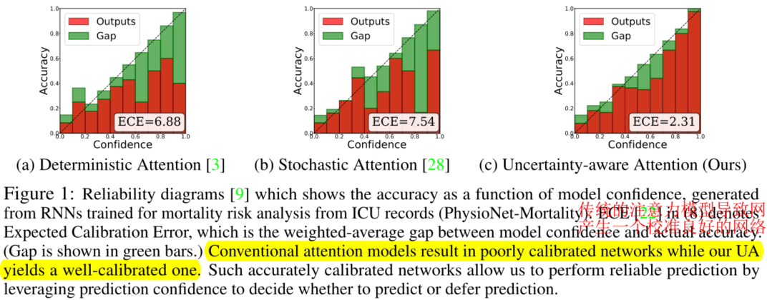
Experiments
Evaluation of prediction reliability
A very important goal we aimed to achieve with the modeling of uncertainty in attention is achieving reliability in prediction. (另一个重要的目标是通过modeling attention uncertiuanty，能够提升predition的可靠性)
Some work show that the SOTA DNN is not reliable as they are not well-calibrated to correlate with model confidence.
Thus, to demonstrate the reliability of the UA model, this paper evaluate it for the uncertainty calibration performance against baselines. (SOTA DNN是不可靠的，因为它们没有很好地校准模型置信度。因此，为了证明UA的可靠性，可以评估baseline与UA的uncertainty calibration performance)

Slide 14
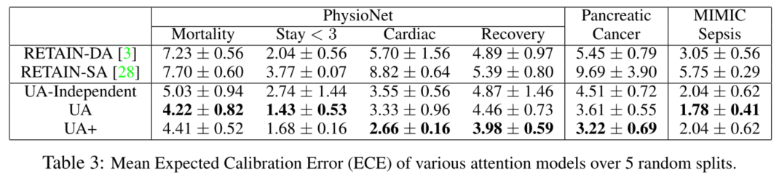
Experiments
Evaluation of prediction reliability
UA are significantly better calibrated than baselines, which shows that independent modeling of variance is essential on obtaining well-calibrated uncertainties.

Slide 15
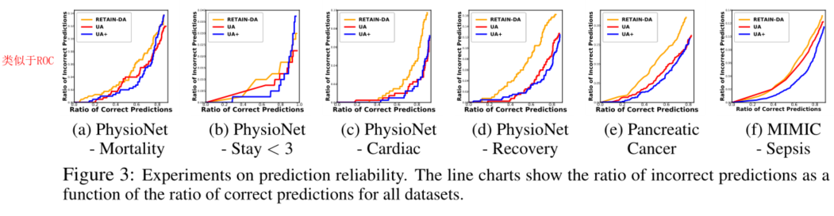
Experiments
Prediction with "I don't know" option
Measure the uncertainty of each prediction by sampling the variance of the prediction using both MC-dropout and stochastic Gaussian noise over 30 runs.
Plotting the ratio of incorrect predictions as a function of the ratio of correct predictions, by varying the threshold on the model confidence.
At the same ratio of the correct predictions, UA output much smaller ratios of the incorrect predictions.

Slide 16
U-CAM: Visual Explanation using Uncertainty based Class Activation Maps
Patro, Badri N., et al. "U-cam: Visual explanation using uncertainty based class activation maps." Proceedings of the IEEE International Conference on Computer Vision. 2019.
Code: https://delta-lab-iitk.github.io/U-CAM/

Slide 17
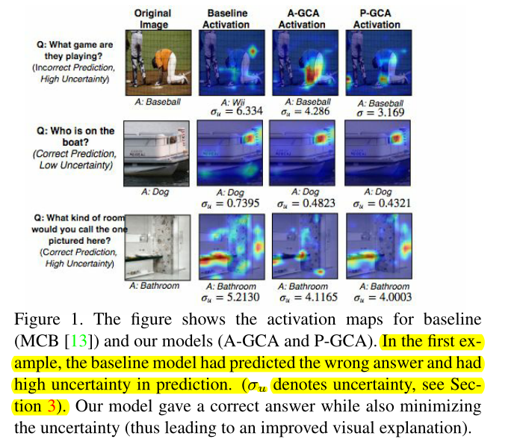
Introduction
Understanding and explaining deep learning models is an imperative task.
This paper propose a method that obtains gradient-based certainty estimates that also provide visual attention maps.
Key idea: Using gradients uncertainty losses to improve attention maps, enhancing the explainability

Slide 18
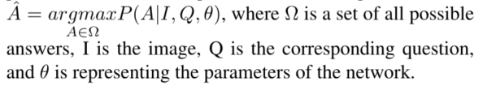
VQA task
Multi-class classification task
A typical open-ended VQA task
A combined (image + question) input embedding is fed to the model.
The output logits are fed to softmax, giving probabilities of the predictions in the multiple-choice answer space.

Slide 19
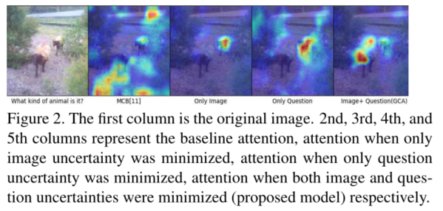
Data Uncertainty in multi-modal setting
Uncertainty in VQA task is two-fold (image + question)

Slide 20
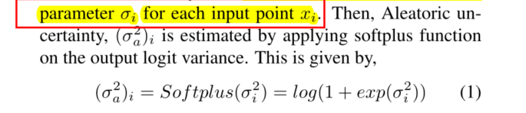
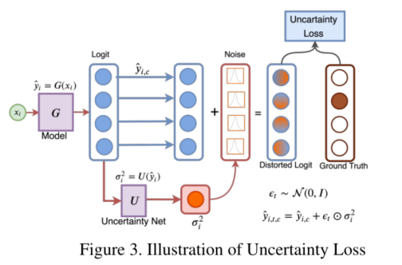
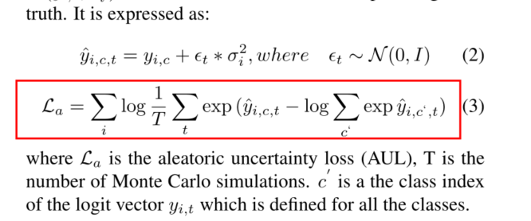
Model Aleatoric Uncertainty
Heteroscdestic aleartoric uncertainty: learn the observational noise parameter σ for each input point x.
Aleatoric uncertainty loss (AUL)

Slide 21
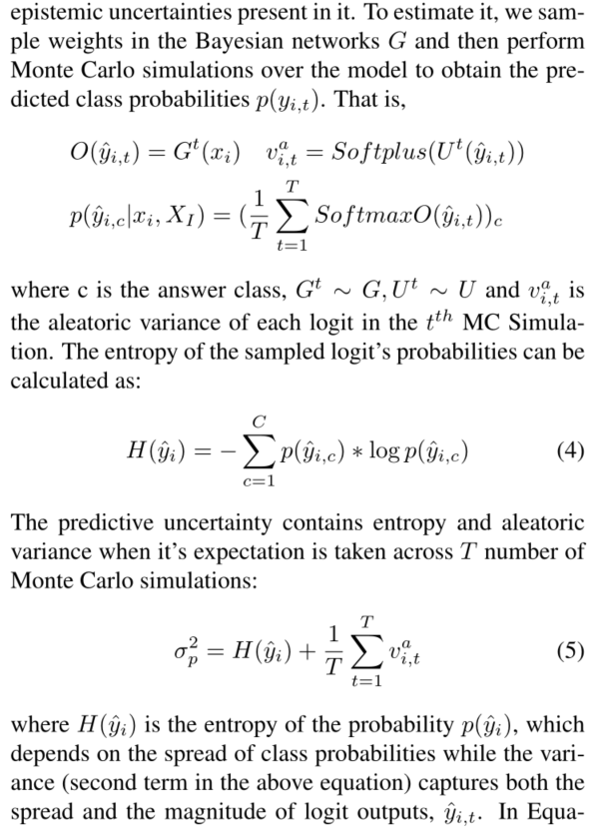
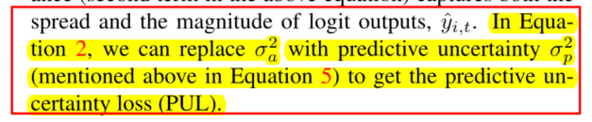
Model Predictive Uncertainty

Slide 22
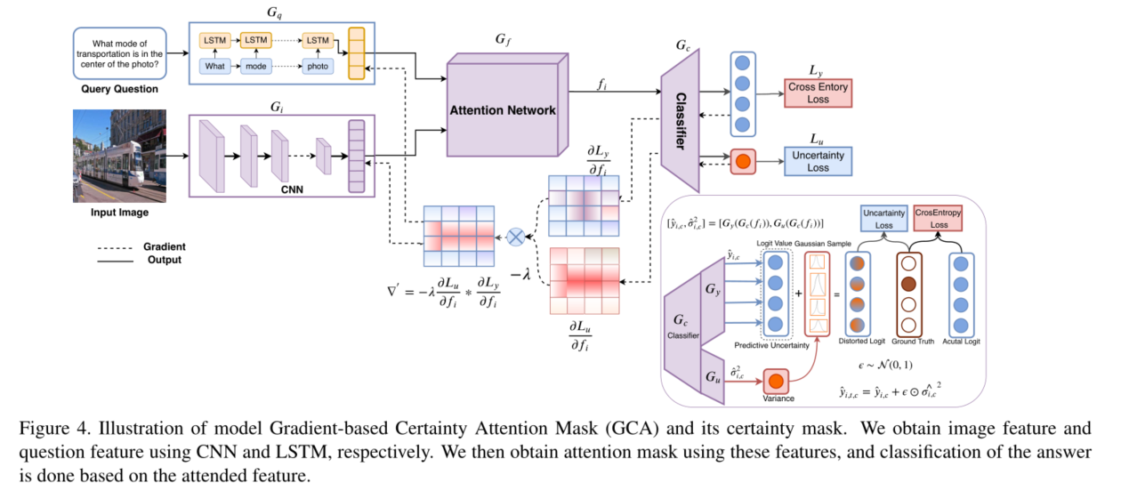
Architecture
Three main parts:
Attention Representation
Uncertainties estimation
Computing gradients of uncertainty losses
Notes:
Attention Representation
Obtain a image feature embedding using a CNN
Obtain a question feature embedding using a LSTM network
Both features are fed into an attention network that combines the image and question embeddings using a weighted softmax function and produces a weighted output attention vector gf.
In this paper, use SAN and MCB (SCN-> stacked attention networks for image question answering) (MCB: Multimodal compact bilinear pooling for visual question answering and visual grounding)
Using the attention network to obtain attention feature
The attention feature is passed through a classifier and the model is trained using the cross-entropy loss
Estimating Uncertainties: Aleatoric & Predictive
Aleatoric-GCA (A-GCA)
Predictive uncertainty loss (PUL)
Predictive-GCA (P-GCA)
Next, Compute the gradients of standard classification loss and uncertainty loss with respect to attentioned image feature.

Slide 23
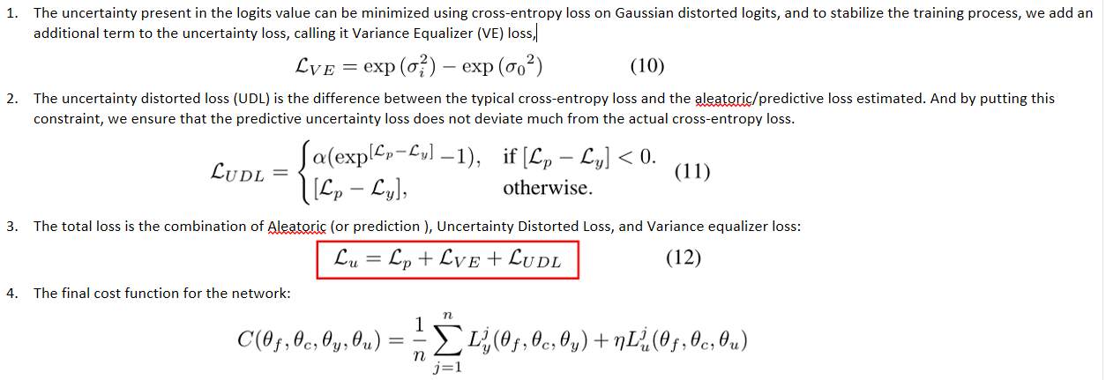
Cost Function

Slide 24
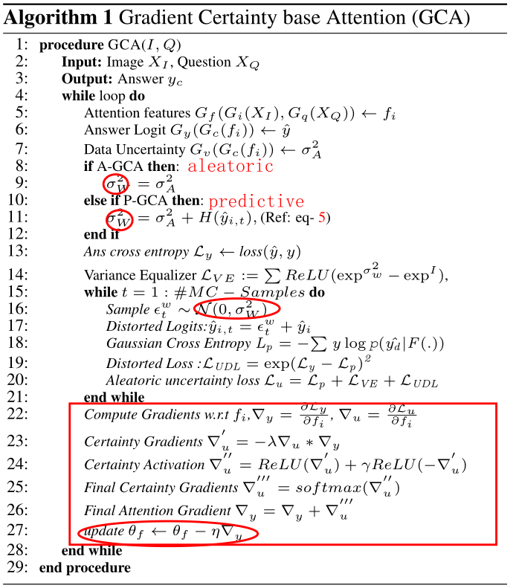
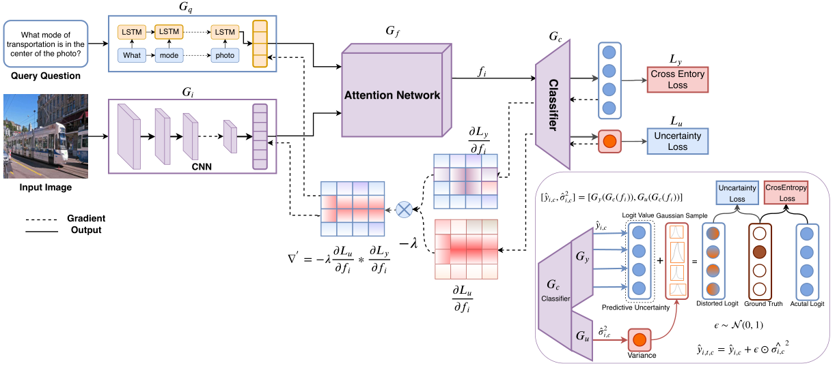
Algorithm

Slide 25
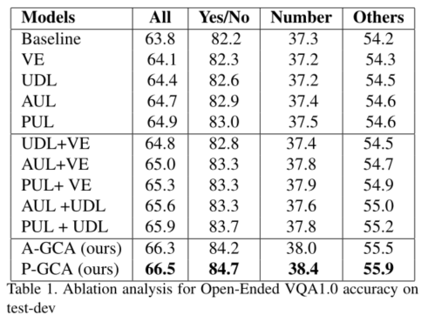
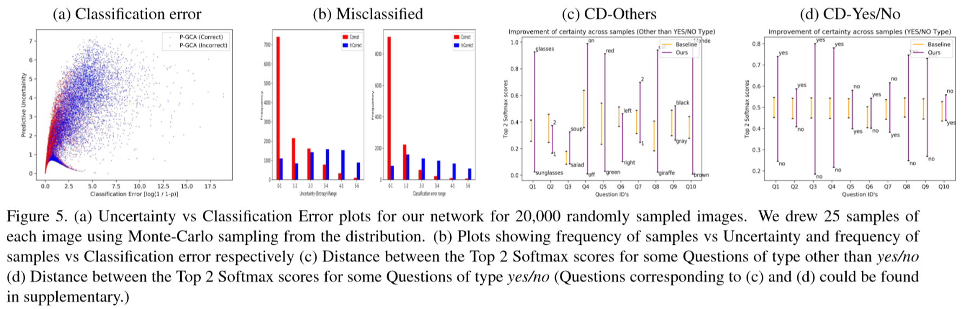
Experiments
Ablation study Uncertainty
Notes:
1. As seen, PUL, when used individually, outperforms the other 4. This could be attributed to PUL guiding the model to minimize both the data and the model uncertainty. （可以看到，当单独使用PUL时，其性能优于其他4个。这可以归因于PUL指导模型最小化数据和模型的不确定性。）
2. 全部项都加上之后效果最好
1. plotted Predictive uncertainty (Figure5(a,b)) of some randomly chosen samples against the Classification error. As seen, when the samples are correct, they are also certain and have less Classification Error (CE).（图5(a,b))绘制了一些随机选取的样本相对于分类误差的预测不确定性,可以看出，当样本是正确的，它们也是确定的，分类误差(CE)更小。）
2. 第二个图是分类正确与否与uncertainty的关系
3. To visualize the direct effect of decreased uncertainty, we plotted (Figure- 5(c, d)). It can be seen that how similar classes like (glasses, sunglasses) and (black, gray), etc., thus leading to uncertainty, got separated more in the logit space in the proposed model.
（为了使不确定性降低的直接影响形象化，我们绘制了(图- 5(c, d))。可以看出，在提出的模型中，(glasses，太阳镜)和(black, gray)等导致不确定性的相似类在logit空间中被分离得更多）

Slide 26
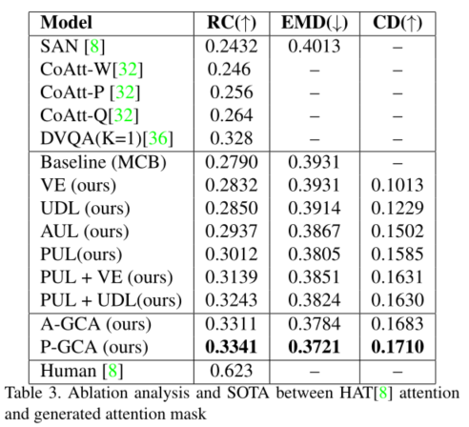
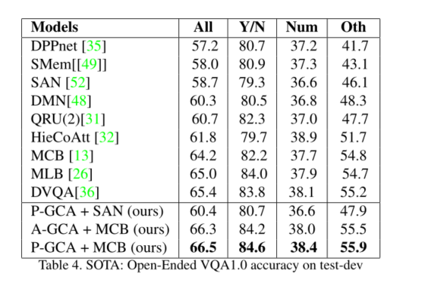
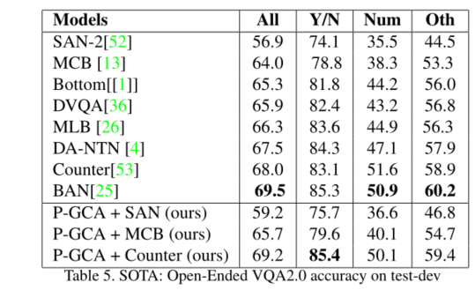
Experiments
Analysis of attention maps and accuracy
Notes:
Compare attention maps produced by our proposes GCA model, and it’s variants with the base model.
Rank correlation and EMD score are calculated for the produced attention map against humanannotated attention (HA T) maps . (对生成的注意图与人工注意图计算Rankl correlation和EMD score)

Slide 27
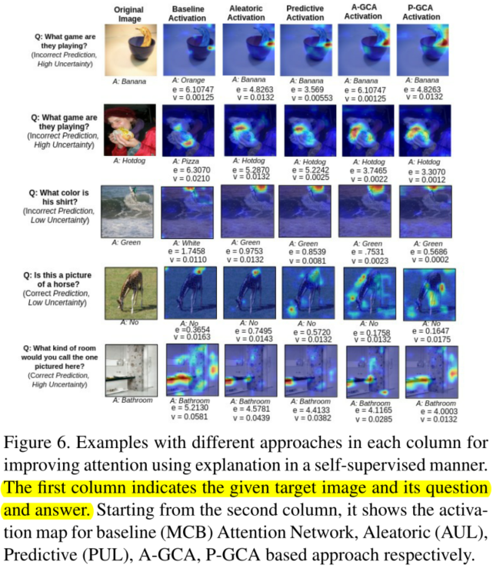
Experiments
Notes:
The first raw, the baseline model misclassifies the answer due to high uncertainty value, that gets resolved by our methods(P-GCA). (第一个原始模型，基线模型由于不确定值高而导致答案分类错误，通过我们的方法(P-GCA)来解决)
We can see how attention is improved as we go from our baseline model (MCB) to the proposed Gradient Certainty model (P-GCA). For example, in the first row, MCB is unable to focus on any specific portion of the image, but as we go towards the right, it focuses the cup bottom, (indicated by intense orange color in the map ( 从我们的基线模型(MCB)到提出的梯度确定性模型(P-GCA)，我们可以看到注意力是如何得到改善的。例如，在第一行中，MCB无法聚焦于图像的任何特定部分，但当我们向右移动时，它聚焦于杯底(图中强烈的橙色表示)

